Slide 1
WaTER QUALITY Dataset for Uganda Districts
NAME: DHIKUSOOKA JOSHUA
Regno: 2022/hd05/22178u
StudentNo: 2200722178

Slide 2
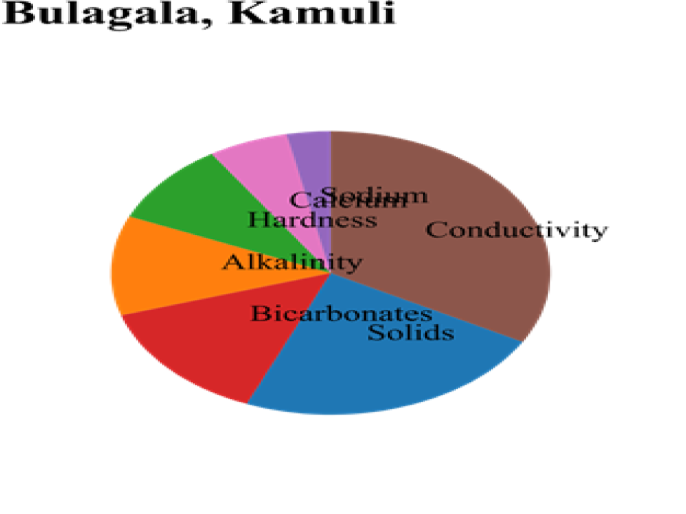
Bulagala, KAmuli
Different parameters where used to evaluate quality of water
Sodium, Solids, Alkalinity, Hardness, Bicarbonates and Conductivity
In Bulagala, kamuli- water bodies have lots of solids

Slide 3
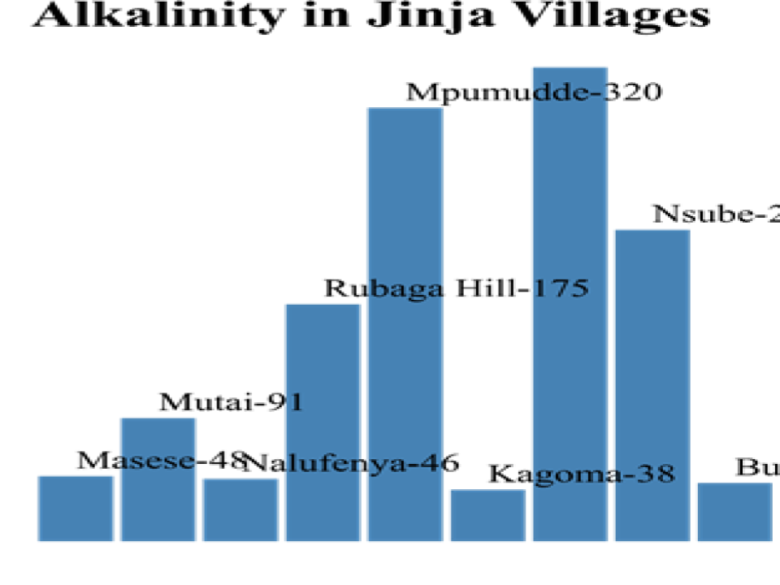
Alkalinity levels of water bodies in jinja villages
Alkalinity levels for village mpumudde tell us the ability for water bodies to neutralize acid
This show how water bodies in kagoma are not good at preventing water from becoming too acidic

Slide 4
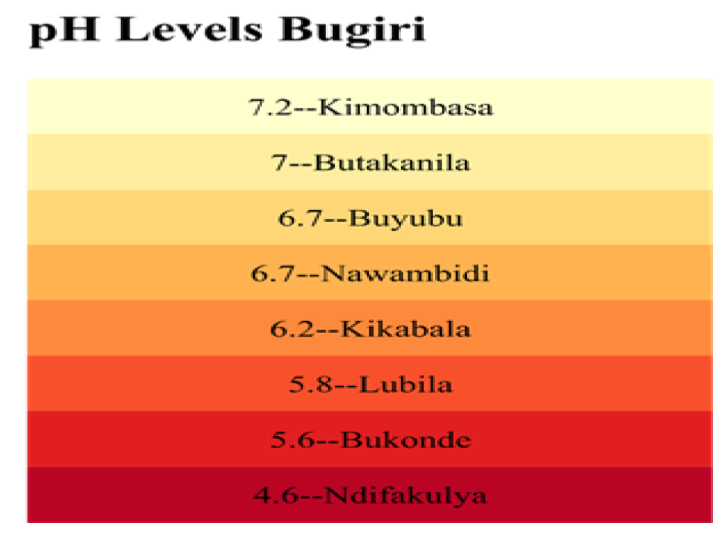
PH levels in bugiri district
We use PH to measure acidity of water
Where most aquatic animals prefer 6.5 to 8.5
Most acidic water bodies are in ndifakulya
Least acidic water bodies in kimombasa village

Slide 5
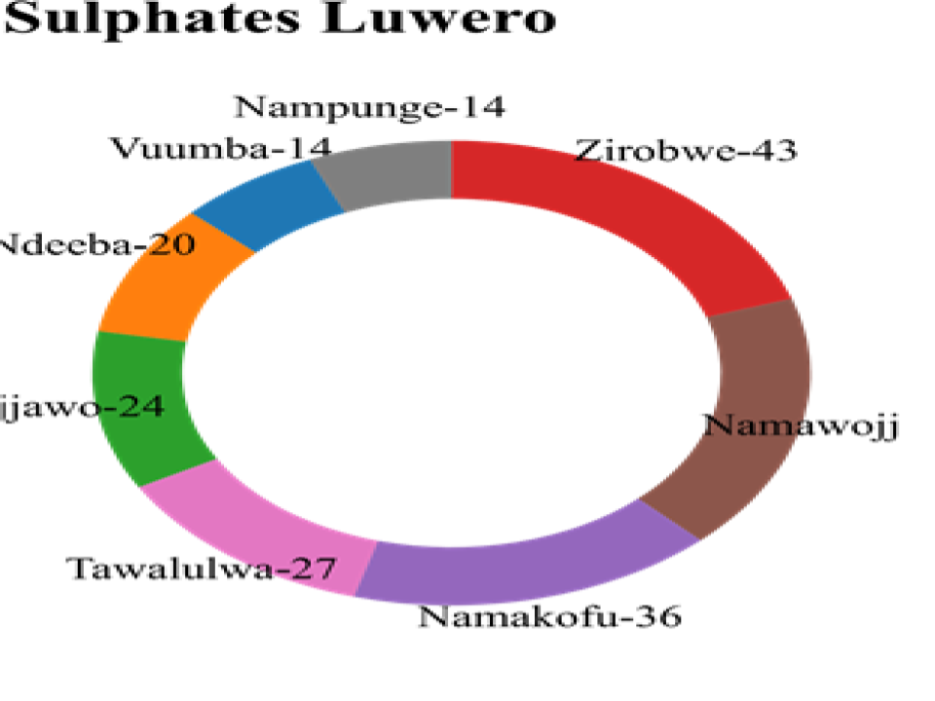
Sulphate levels in luwero district water bodies
Certain geological formations, such as those containing sulfide minerals, can contribute to higher sulfate levels in groundwater.
This information tells us that there is a possibility of sulphide minerals in namakofu , Luwero compared to other villages

Slide 6
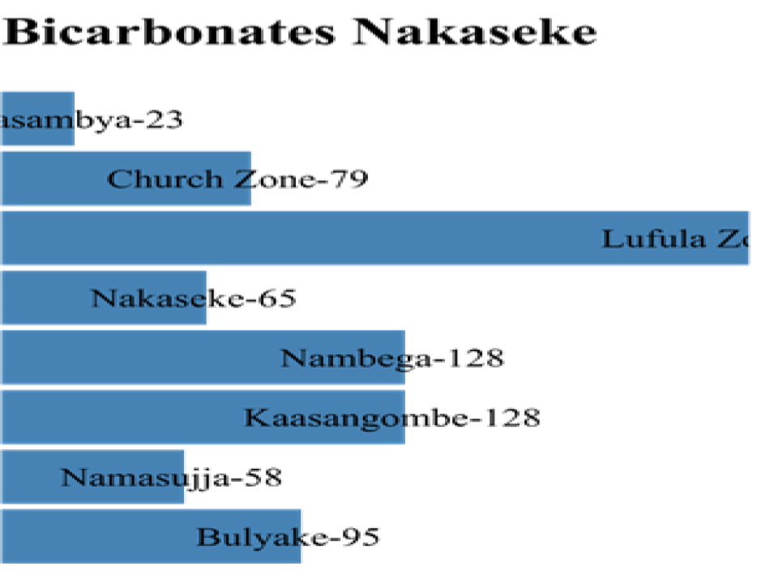
Bicarbonates concentration in nakaseke district
Bicarbonates help prevent water from becoming too acidic.
Based on the Lufula Zone we see high bicarbonates concentration in water

Slide 7
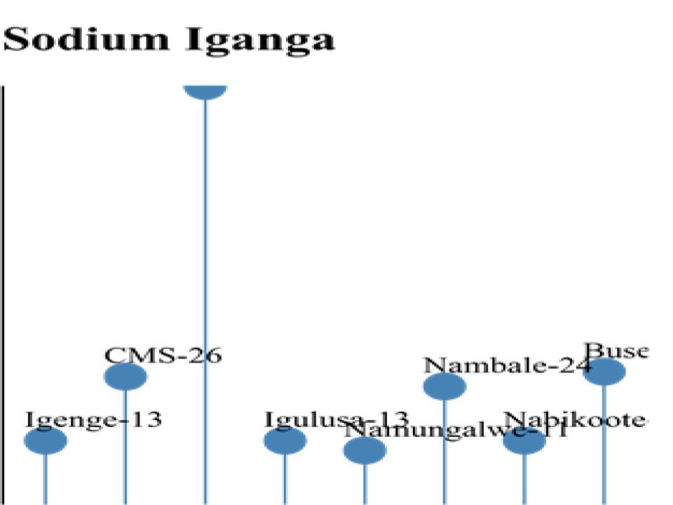
Sodium levels in the different water bodies in iganga
This parameter sodium is also used to evaluate water quality.
Where individuals restricted on sodium intake may not used water from water bodies with high levels of sodium

Slide 8
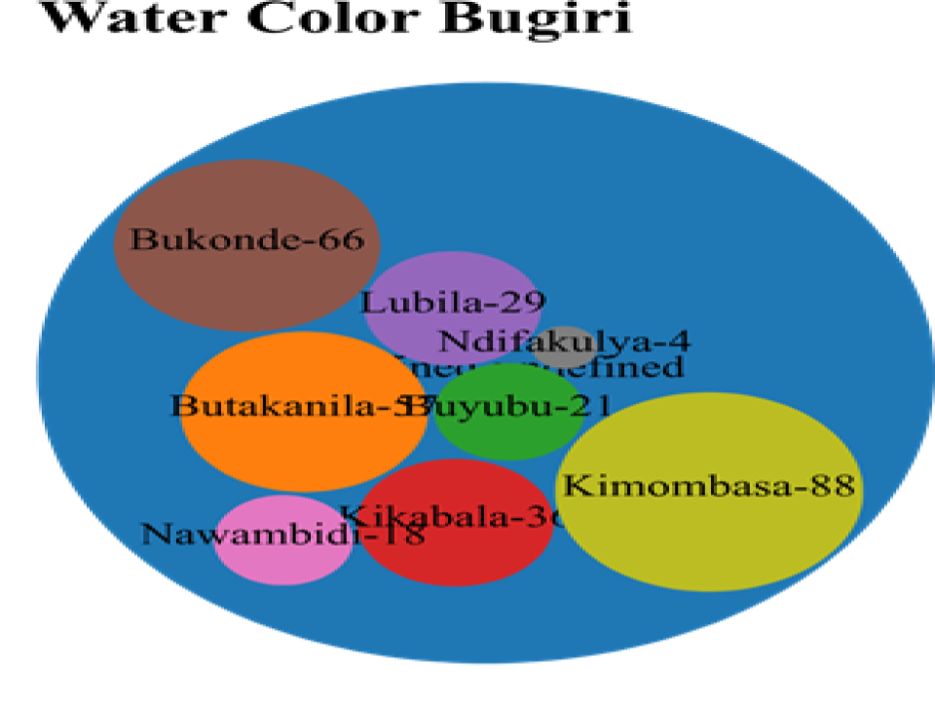
Water color of water bodies in Bugiri district
excessive coloration may be aesthetically unpleasing
Kimombasa leads in Coloration.
This tells us to question water purities based on the color

Slide 9
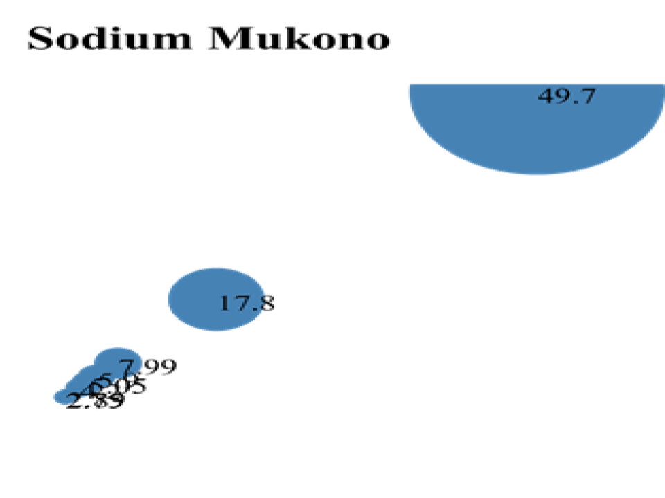
Sodium concentration in water bodies in Mukono district
This bubble graph show most water bodies in Mukono are bellow 17.8 and afew outliners.
World Health Organization (WHO) suggests that the concentration of sodium in drinking water should not exceed 200 mg/L

Slide 10
Thanks

